Slide 1

LiquID: A Wireless Liquid IDentifier
Ashutosh Dhekne, Mahanth Gowda, Yixuan Zhao, Haitham Hassanieh, Romit Roy Choudhury
University of Illinois, Urbana-Champaign
Notes:
Thank you for the introduction. Hello everyone, I am Ashutosh Dhekne. I am here to talk about “LiquID: A Wireless Liquid IDentifier”. This work has been done with my collaborators Mahanth, Yixuan, Haitham, and Romit. We are all from the University of Illinois at Urbana Champaign.

Slide 2
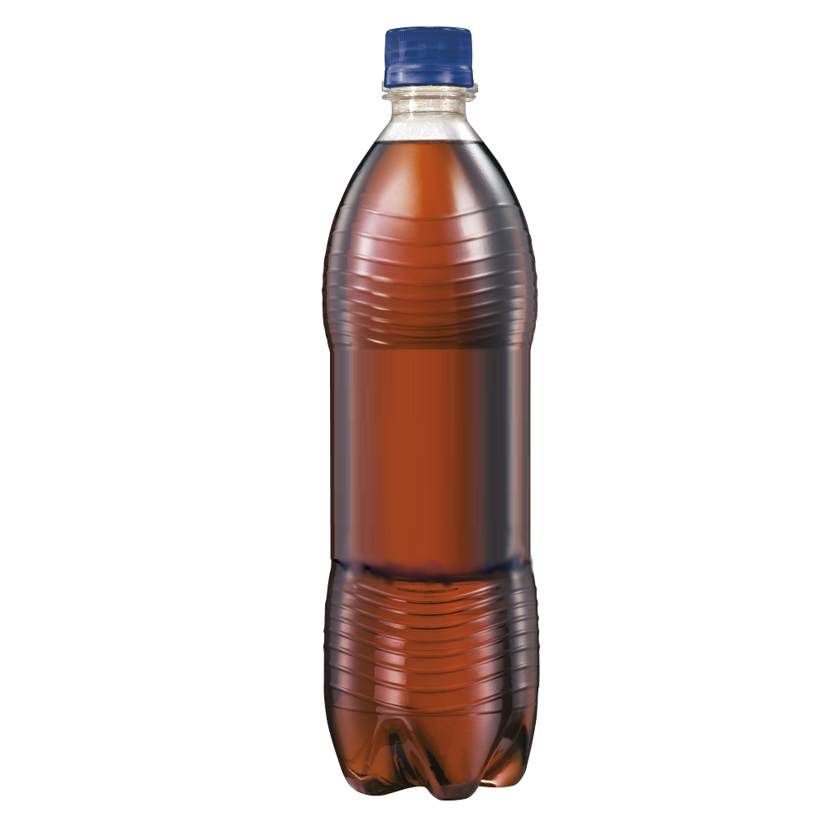
Notes:
The goal of this work is to identify liquids using wireless signals. We would like to transmit wireless signals through an unknown liquid, observe the properties of the received signals and ...

Slide 3
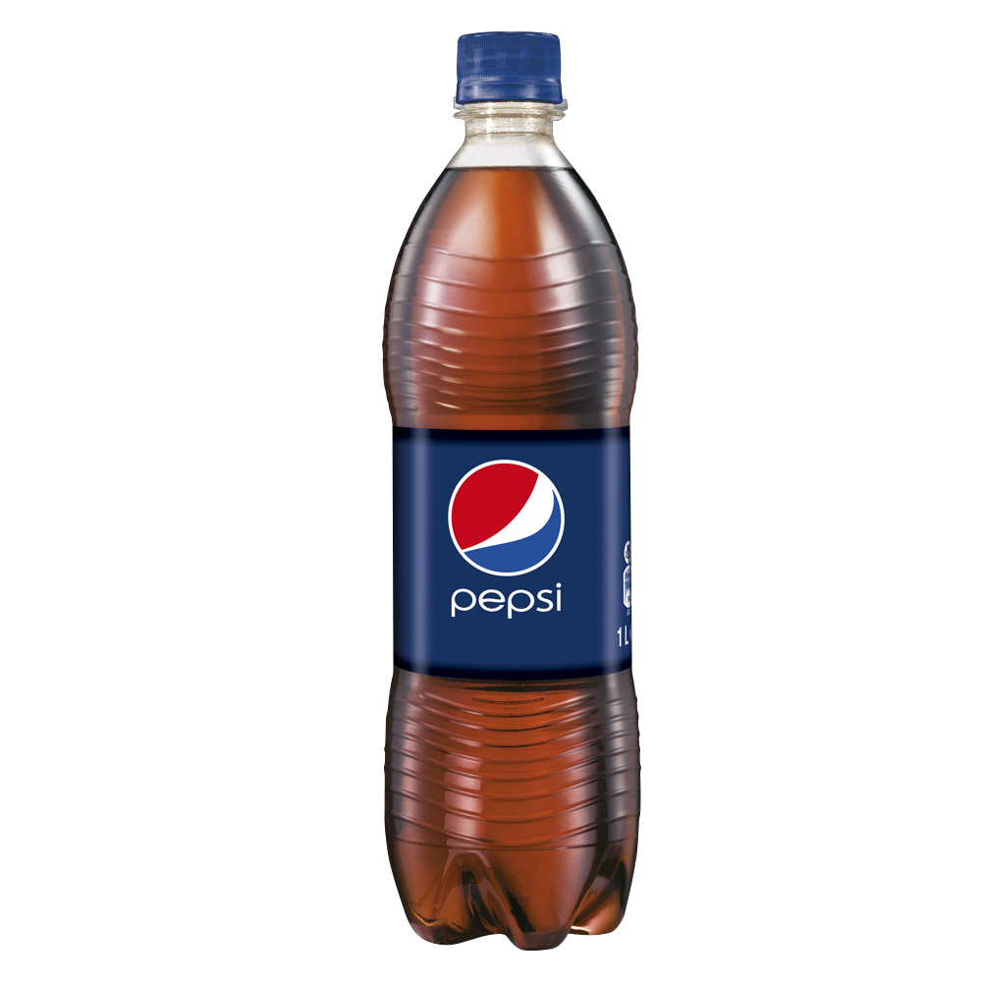
Pepsi
Notes:
…say that it is actually Pepsi.

Slide 4
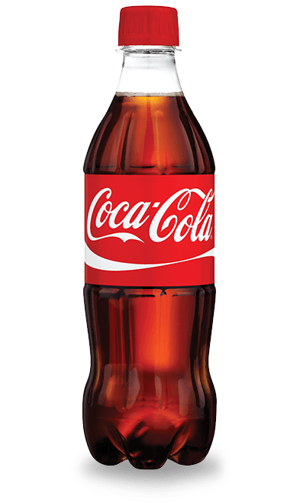
Pepsi
Coca-Cola
Notes:
We want to obtain such precision that we will be able to even distinguish between Pepsi and Coke using the same approach.

Slide 5
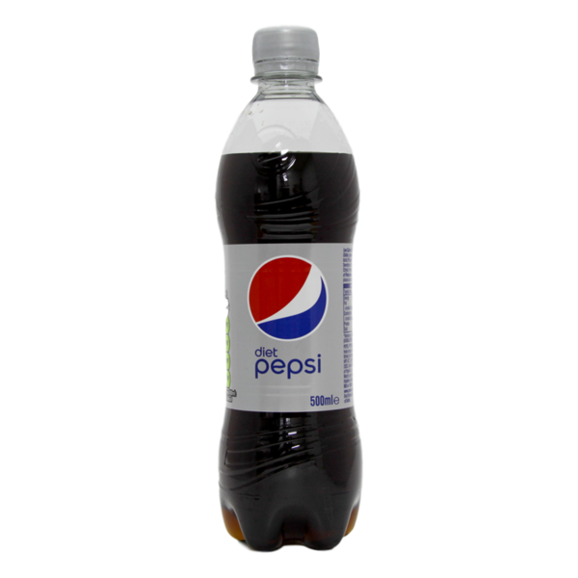
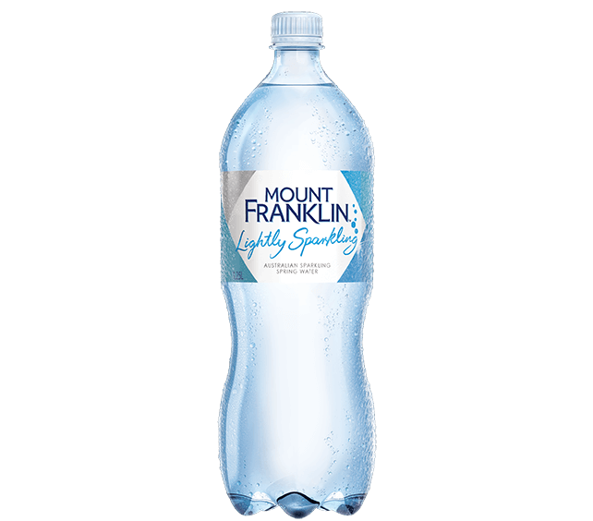
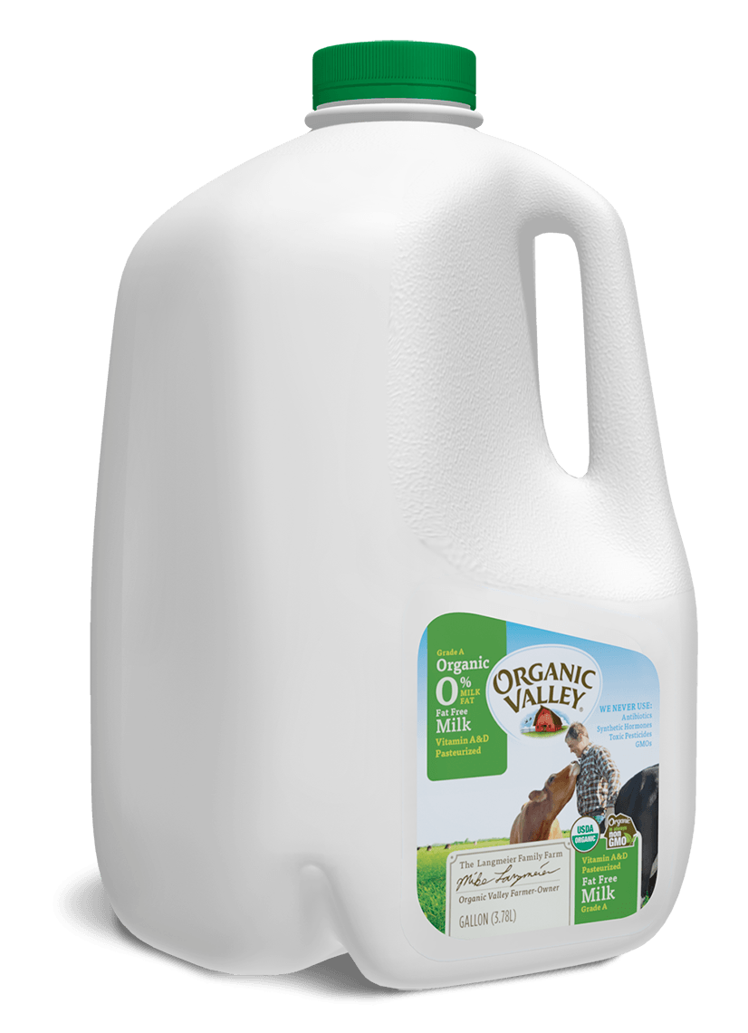
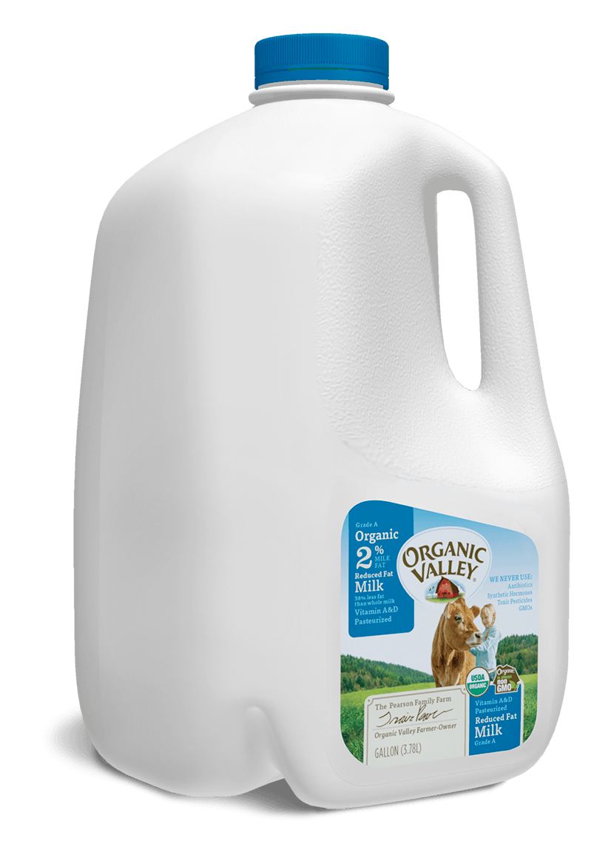
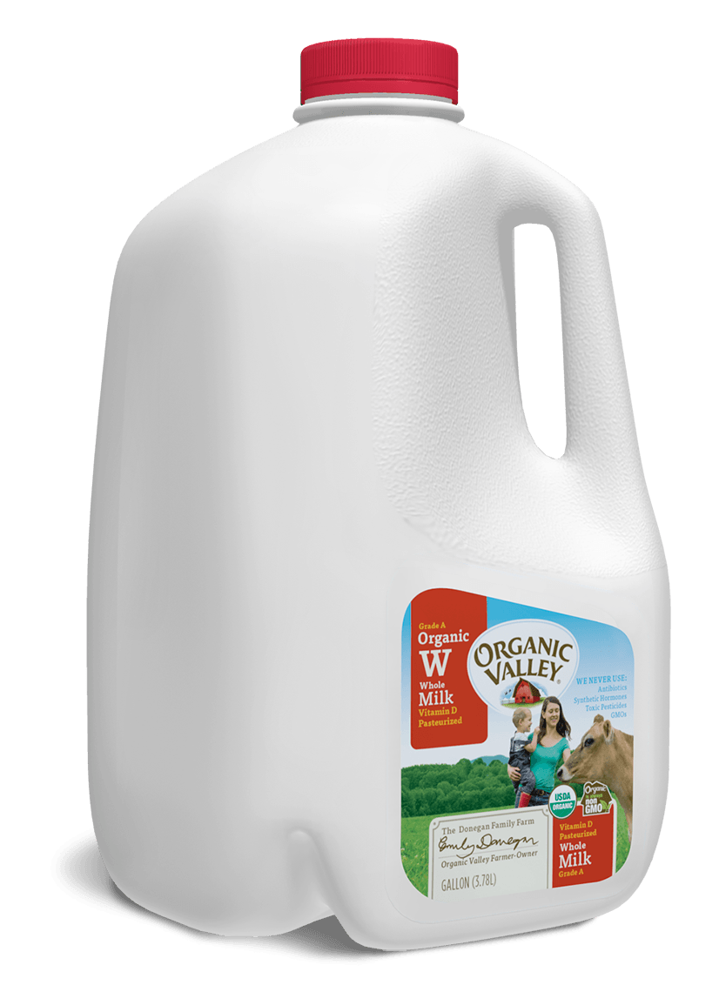
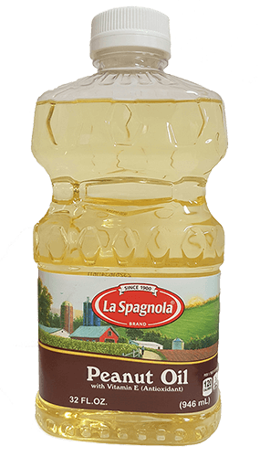
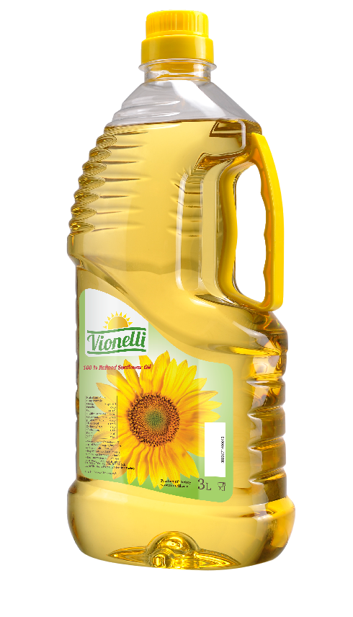
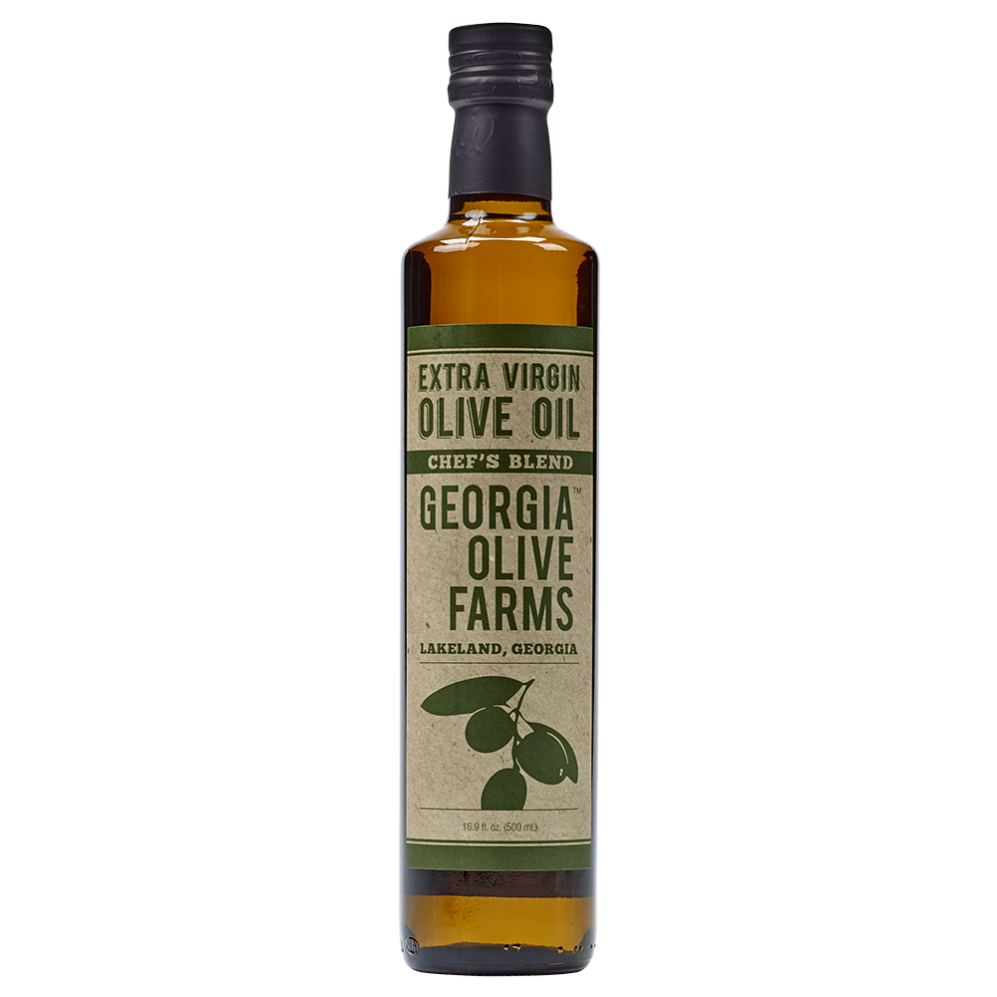
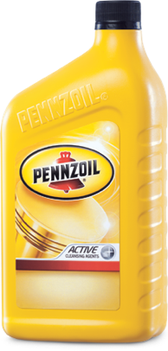
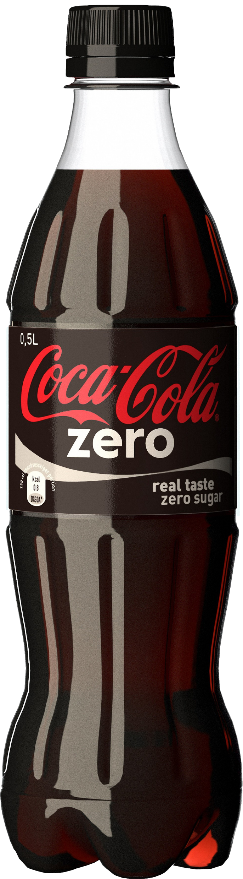
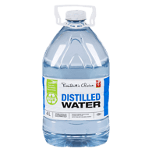
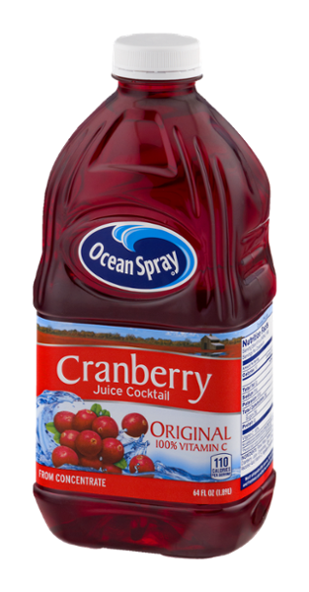
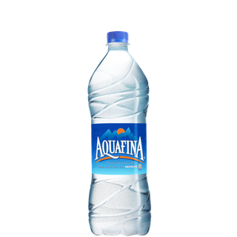
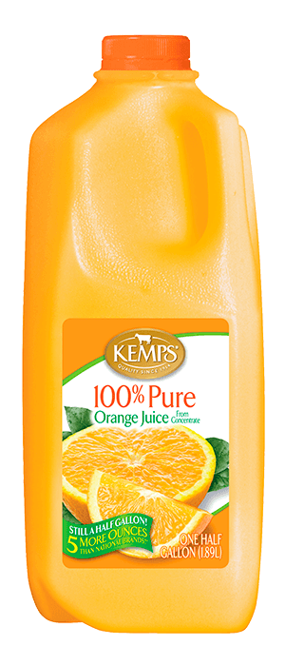
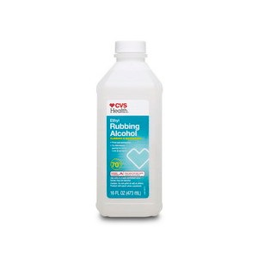
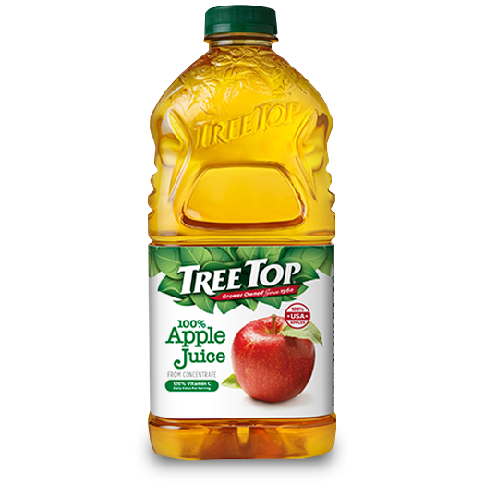
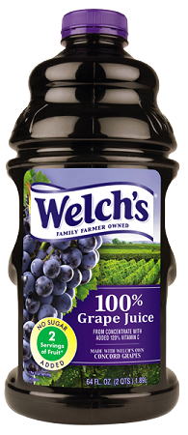
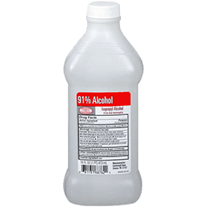
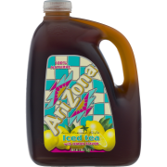
Notes:
And not just that, we would like to distinguish between a wide variety of liquids: carbonated drinks, apple juice, orange juice, whole milk, skimmed milk, olive oil, peanut oil, alcohols, and even distilled water and mineral water.

Slide 6
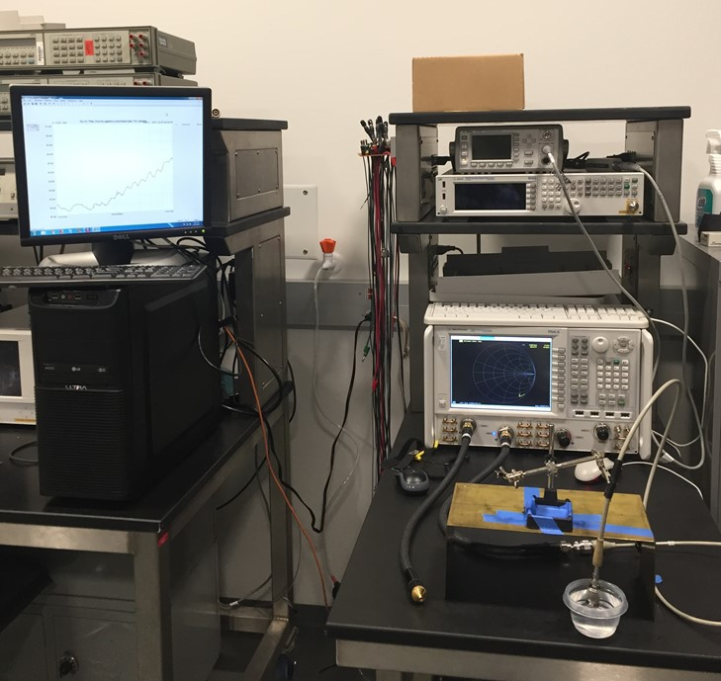
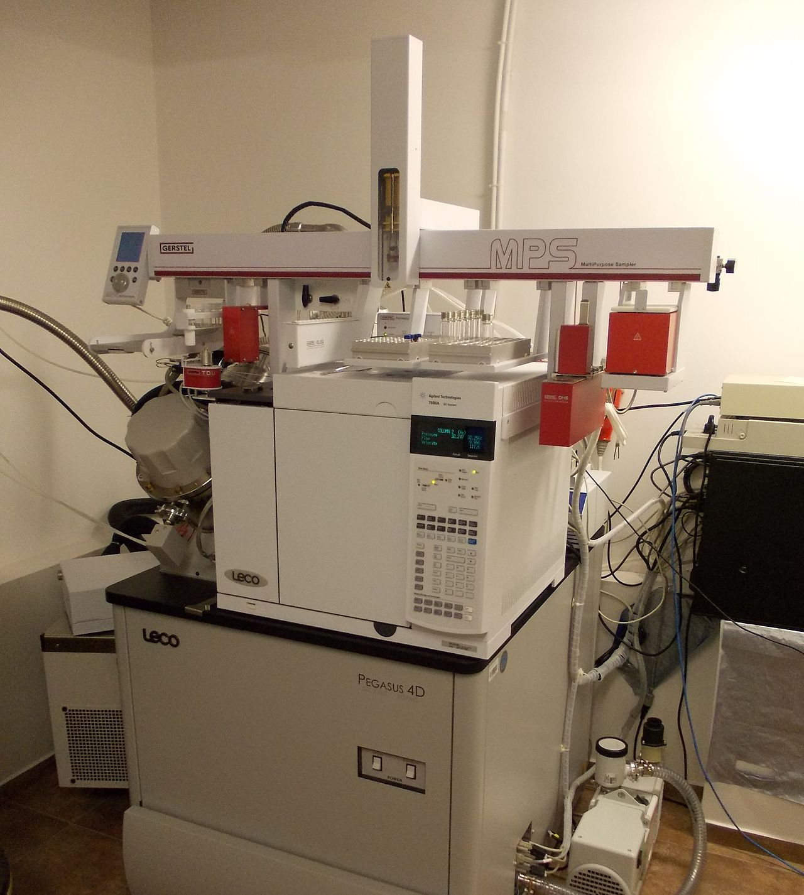
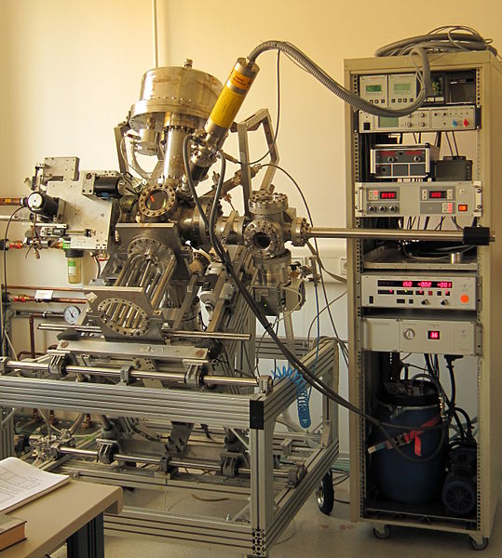
Existing Solutions
Notes:
Lots of work has gone into understanding properties of liquids and identifying them. However, there are three key limitations of these techniques.

Slide 7
Existing Solutions
Dipping Probe
Chemical Analysis
Expensive
Notes:
These techniques either require dipping a probe into the liquid, or require chemical analysis which heats, treats, or beats the sample and rendering it unsuitable for later consumption, and these equipment are generally very expensive – to the tune of hundreds of thousands of dollars.

Slide 8
Benefits of LiquID
Pepsi
✓ Identifies liquid without touching it – Non-invasive
✓ Passes wireless signals – Non-destructive
✓ Small and inexpensive – Convenient
Notes:
In contrast, we want to enable liquid identification without touching the liquid. By simply passing wireless signals through the liquid and using inexpensive $100 equipment.

Slide 9
Applications
Notes:
As a result, this opens up a variety of applications.

Slide 10
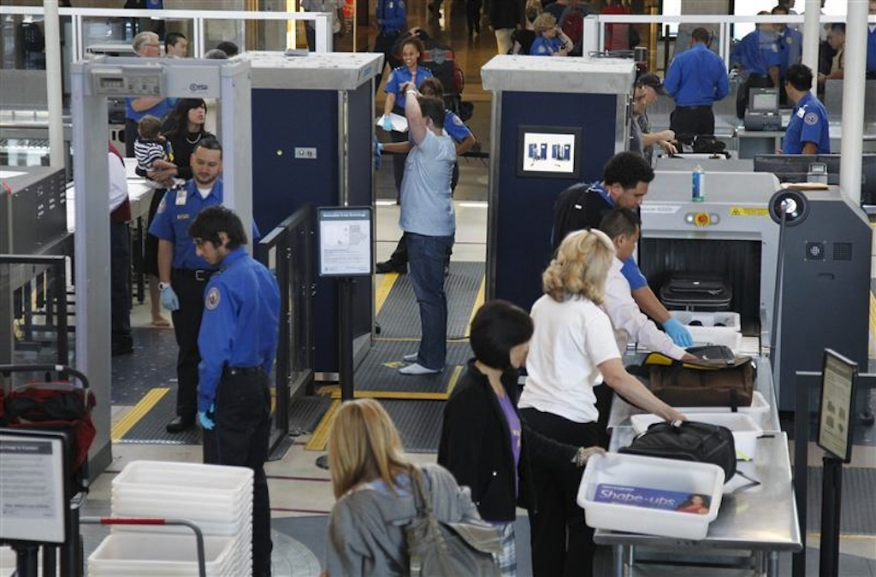
Application 1: Airport Security
Notes:
One application is in airport security. Today, we are not allowed to carry more than 3 ounces of liquids in our carry-on bags. If we enable a simple non-invasive way to identify liquids, we might be able to carry a bottle of water without problems.

Slide 11
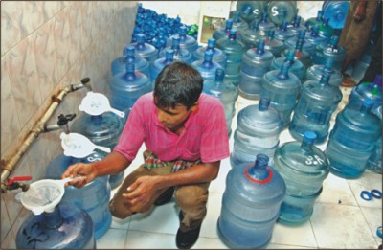
Application 2: Water Adulteration
Notes:
In many places around the world, contaminated tap water is sold under the guise of mineral water. If we could create a device that can quickly identify one from the other, it will be very useful in countries such as India.

Slide 12
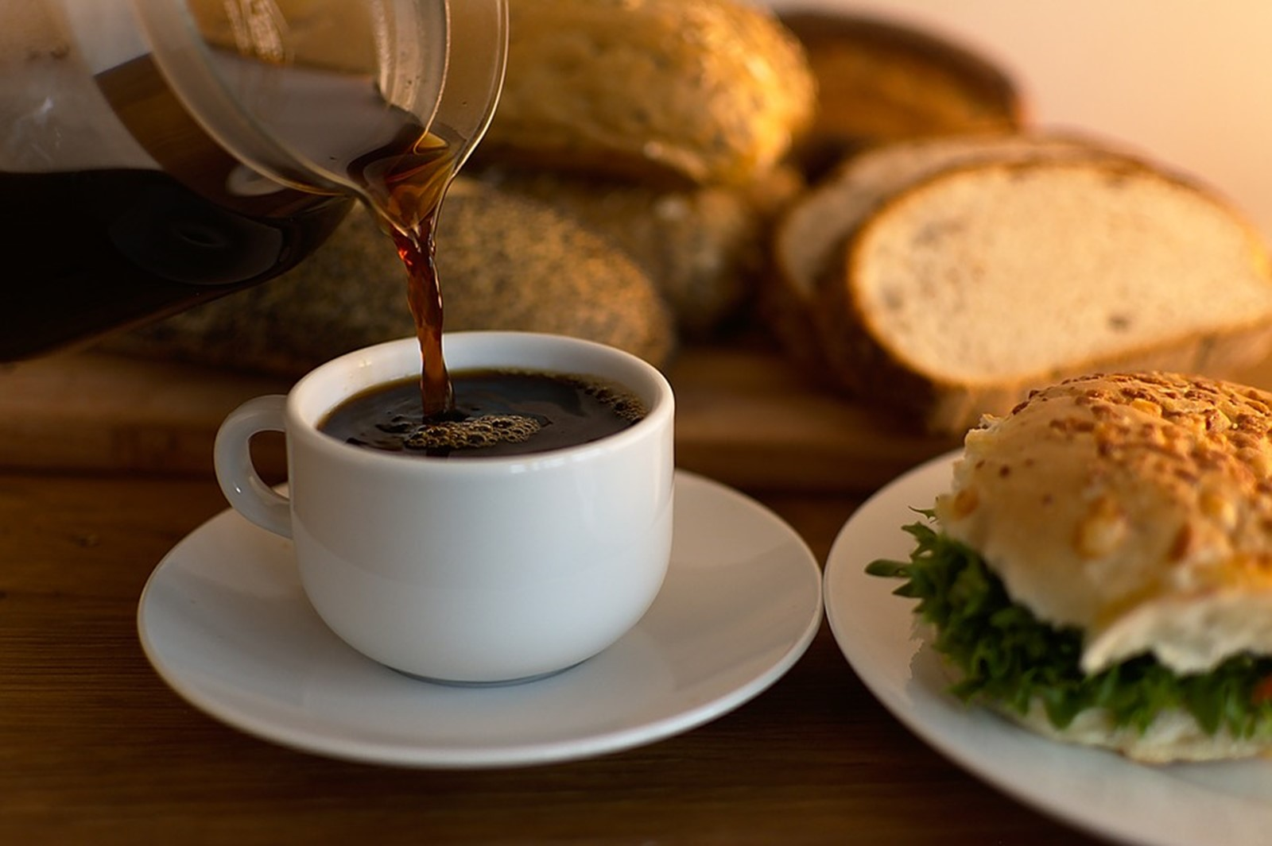
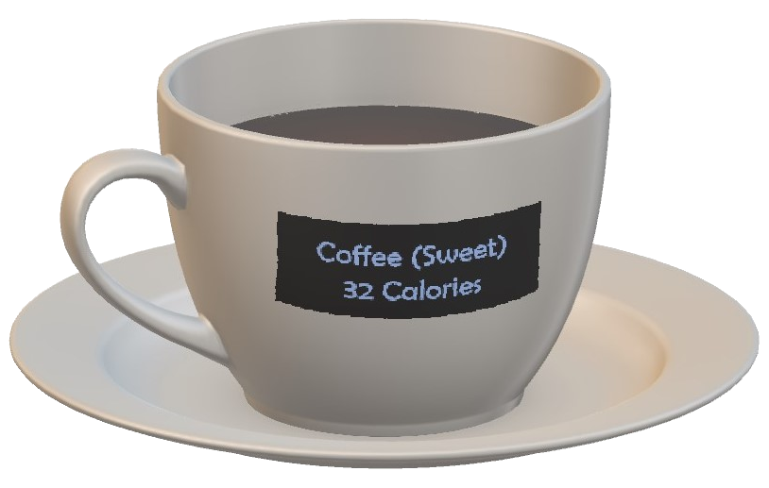
Application 3: Calorie Cup
Notes:
Maybe we can create a smart cup that identifies the liquid a user is consuming and records the calorie intake without any input from the user.

Slide 13
How?
Notes:
Now that we know what we want to achieve, the question is how do we get there? For this we want to understand how signals behave inside the liquid.

Slide 14
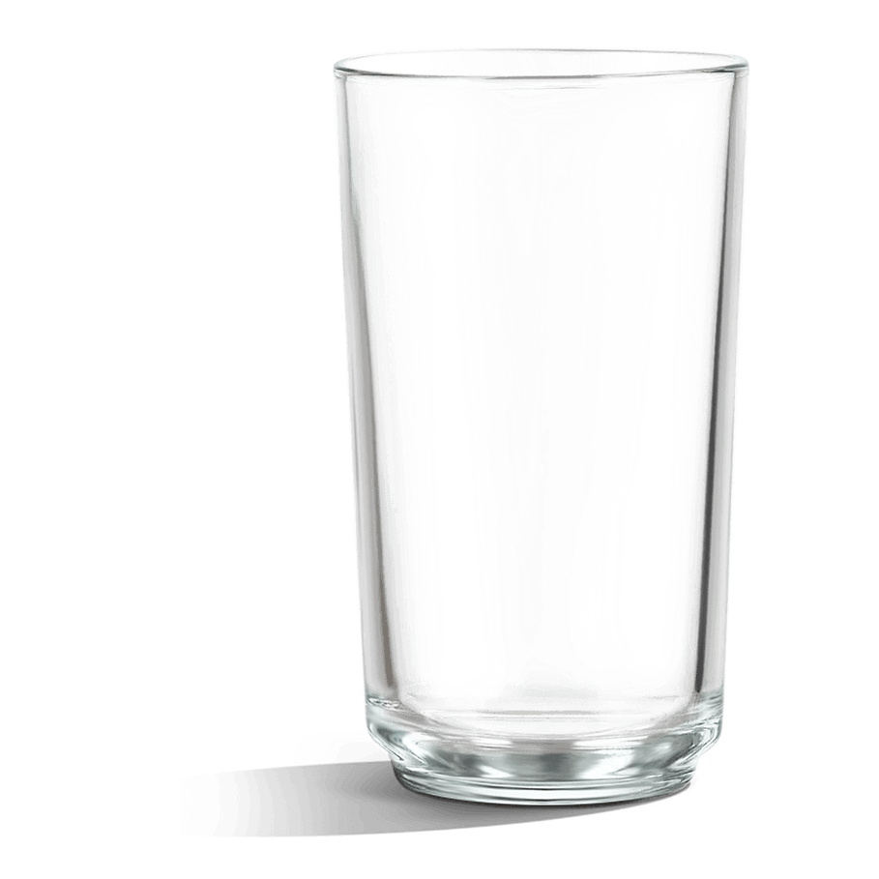
Key Properties of Liquid
Bending
Absorption
Notes:
When we shine a wireless signal onto a liquid, there are two key properties that play a role. First, the signal get absorbed inside the liquid, and second, it bends towards the normal.

Slide 15
Key Properties of Liquid
Bending → Refractive Index
Unique Tuple
Absorption → Attenuation Factor
Notes:
The signal bending is due to the liquid’s refractive index, and the reduction in signal strength is due to its attenuation factor. These two properties together form a tuple, which is quite unique for every liquid.

Slide 16
Key Properties of Liquids
Refractive index
Attenuation factor
Notes:
So now, we have to measure refractive index and attenuation .

Slide 17
Attenuation Factor
Reduced
signal strength
Notes:
Amongst these two properties, let us look at the easier one first. If we shine a signal and measure the amplitude of the received signal, we can tell how much the signal is being absorbed. So the attenuation factor is not very difficult. Let us then zoom into the refractive index.

Slide 18
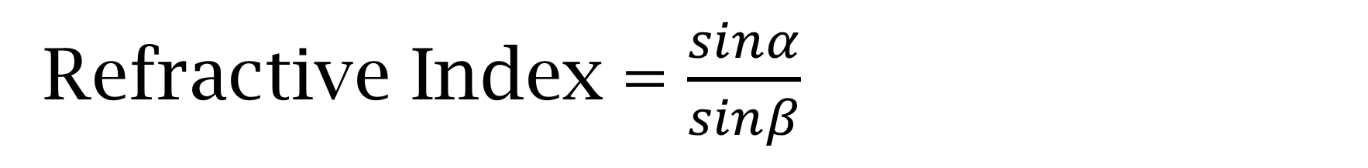
Refractive Index = $\frac{sinα}{sinβ}$
β
α
Notes:
Most of us think about the refractive index as the ratio of the incident angle to the refracted angle, in this example, sin(alpha) by sin(beta). As signal passes into a different material, the signal bends giving us these two angles. These angles can be measured well when optical rays are incident on the liquid. With wireless signals where the beams cannot be that narrow, it is actually very challenging. There is a lot of work that has corroborated this challenge and textbooks even say that this is not something one should try.

Slide 19
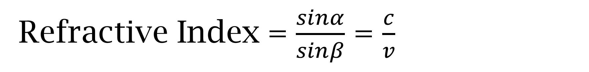
Refractive Index = $\frac{sinα}{sinβ}$ = $\frac{c}{v}$
Velocity c
Velocity v
Velocity c
β
α
Notes:
But there is another interpretation of refractive index which is about the velocity of the signals. If you shine a signal perpendicular to the liquid surface, the signal will not bend but the signal will still slow down. Refractive index is also defined as the ratio of the velocities inside and outside the liquid. That is the opportunity we have. In other words, if we can somehow measure the slowdown of the signal after passing through the liquid, then we know what the refractive index is.

Slide 20
Refractive Index = $\frac{sinα}{sinβ}$ = $\frac{c}{v}$
Velocity c
Velocity v
Velocity c
β
α
Notes:
We will use this approach of measuring the refractive index in this work.

Slide 21
How to measure the slowdown?
Notes:
Which brings us to the question, ”How can we measure this time accurately?”

Slide 22
Wireless Localization
Distance?
Tx
Rx
Notes:
The answer comes from wireless localization literature. In localization and ranging, people are interested in determining the distance between a transmitter and a receiver.

Slide 23
Time of Flight
Time of flight
as a proxy for distance
Tx
Rx
Notes:
And they measure this distance based on the time it takes for wireless signals to travel from the transmitter to the receiver. We call this the time of flight.

Slide 24
Time of Flight
Liquid
ToF with liquid
ToF in air
Tx
Rx
d
Notes:
Now, suppose we insert a liquid column of a known width between the two devices, and again measure the ToF. This ToF will be larger, right? Why? Because the liquid will slow down the signal.

Slide 25
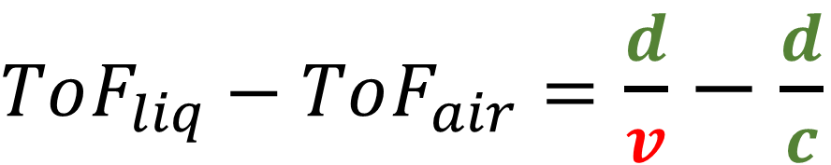
ToF gives Refractive Index
$ToF_{liq}−ToF_{air}=$ $\frac{d}{v}−\frac{d}{c}$
Only unknown
$$Refractive Index=\frac{c}{v}$$
Notes:
Now if we do the math, if I measure the ToF with the liquid
{click}
and then again without the liquid
{click},
the difference in the ToFs is simply…d by v minus d by c, where v is the velocity inside the liquid and d is the width of the liquid.
{click}
The velocity inside the liquid is the only unknown. Thus, by measuring the time of flight very accurately, we can derive the velocity and thereby calculate the refractive index. That is our high level idea in this work.

Slide 26
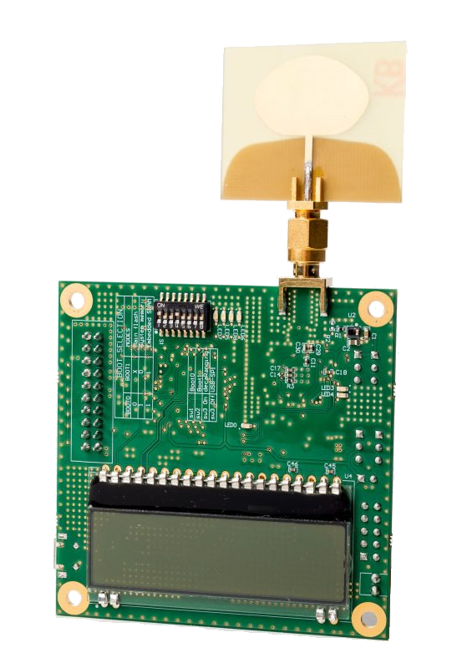
Current State-of-the-art
Ultra-wideband Radios
Inexpensive
1GHz of bandwidth
ToF measurements at 1ns granularity
Notes:
We want to get this delta ToF. Which means we need to measure the ToF individually with and without the liquid. What resources do we have to measure the ToF? Well, UWB radios are available today, they are cheap, and have 1GHz of bandwidth. So, off the shelf they are able to provide ToF measurements at the granularity of 1ns.

Slide 27
Is this good enough?
Notes:
Is this good enough for our purpose?

Slide 28
State-of-the-art is insufficient
≈10 picoseconds
Soybean Oil?
Notes:
The difference in slowdown between Pepsi and Coke is in the order of few picoseconds. So with the nanosecond granularity of the commercial off-the-shelf UWB radios, there is no way we can distinguish the two. In fact, with a nanosecond of error, they could get identified as Soybean oil .

Slide 29
Challenge: Measuring ToF at picoseconds granularity
Notes:
This is the key challenge.

Slide 30
Our Contributions
Architecture to improve ToF
Creates a reference path
Cancels out hardware variabilities
Jointly solve phase and ToF
Resolve the phase integer ambiguity
Allows even better ToF precision
Wire
Tx
Rx
Notes:
To solve this problem, our contributions are two fold. One is architectural
{click} and one is algorithmic.
Let us look at the architectural change first. We introduce a wire between the two devices that allows us to move from absolute measurements to relative measurements which becomes critical to overcome clock synchronization issues. This wired reference path also allows us to cancel many variabilities in the hardware and across different wireless packets.
{click}
Further, we jointly solve the phase of the received signal and ToF thereby bringing down the nanosecond granularity to picoseconds. Let me now elaborate a bit about the technical details of our system. What exactly does connecting a wire between the transmitter and the receiver give us?

Slide 31
Channel Impulse Response
CIR
Tx
Rx
Not Used
Amplitude
Time
Notes:
To understand that, we have to look at the channel impulse response. What is the channel impulse response? When wireless signals are sent by the transmitter, they arrive at a receiver over multiple paths. If each transmitted signal was just an impulse, then a time domain representation of all arriving echoes would be called the channel impulse response. Of course, since we cannot send just an impulse, and due to other filtering artifacts, a practically obtained CIR is more spread out. In most localization use-cases, only the first peak is used since it tells us the distance over the direct path between the two devices.

Slide 32
Channel Impulse Response
Wire
Tx
Rx
CIR Taps
Notes:
By connecting the wire, we have now introduced a new peak in the channel impulse response.

Slide 33
Channel Impulse Response
T_{air}
T_{wire}
Wire
Tx
Rx
CIR Taps
Notes:
The first peak, corresponds to the shorted wired path and the second peak corresponds to the signal received through the air path.

Slide 34
CIR with Liquid
T_{air}
Liquid
T_{wire}
T_{liq}
Wire
Tx
Rx
CIR Taps
Notes:
Now, if we introduce a liquid column between the two antennas and send another wireless signal, the signal will slow down. This slow-down is observable in the channel impulse response. T_liquid is to the right of T_air.

Slide 35
Double Differencing – Relative ToF
T_{air}
e
d
u
T_{wire}
liq
t
ΔT
i
l
air
p
m
A
T_{liq}
0
5
10
15
20
0
500
1000
1500
2000
Time (nanoseconds)
$$ΔT_{air}^{liq}=\left(T_{liq}−T_{wire}\right)−(T_{air}−T_{wire})$$
CIR Tap
Notes:
Now what we really want, is the difference between the blue and the green peak. But these lines correspond to two different wireless packets, so this is not directly measurable. So how do we measure that? The difference between green and blue peak is essentially the difference between blue and red minus the difference between green and red. Both of these are individually measurable quantities.

Slide 36
Double Differencing – Relative ToF
Shows the
slowdown
T_{air}
e
d
Small error in peak detection → Large error in ToF
u
T_{wire}
liq
t
ΔT
i
l
air
p
m
A
T_{liq}
0
5
10
15
20
0
500
1000
1500
2000
Time (nanoseconds)
CIR Tap
36
Notes:
This difference between the green and blue peaks, indicates the slowdown caused by the liquid. Of course, this requires very accurate peak detection in the CIR. A small error in this peak detection can cause a significant error in the estimated slowdown. So now what do we do?

Slide 37
CIR – Phase Information
CIR
90°
Tx
Rx
Amplitude
180°
0°
Time
270°
Notes:
There is some more information in the CIR that we have not yet used. Every point in the CIR also has a corresponding phase. The phase tells us how much fraction of the wavelength a signal has traveled. Of course, it could have traveled more than a wavelength, and phase cannot tell us the number of integer wavelengths it has traveled. But, we will worry about that later.
For now, observe that phase information is obtained directly from the initial sampling of the various paths that were received at the Rx antenna and is unaffected by the sinc filters.

Slide 38
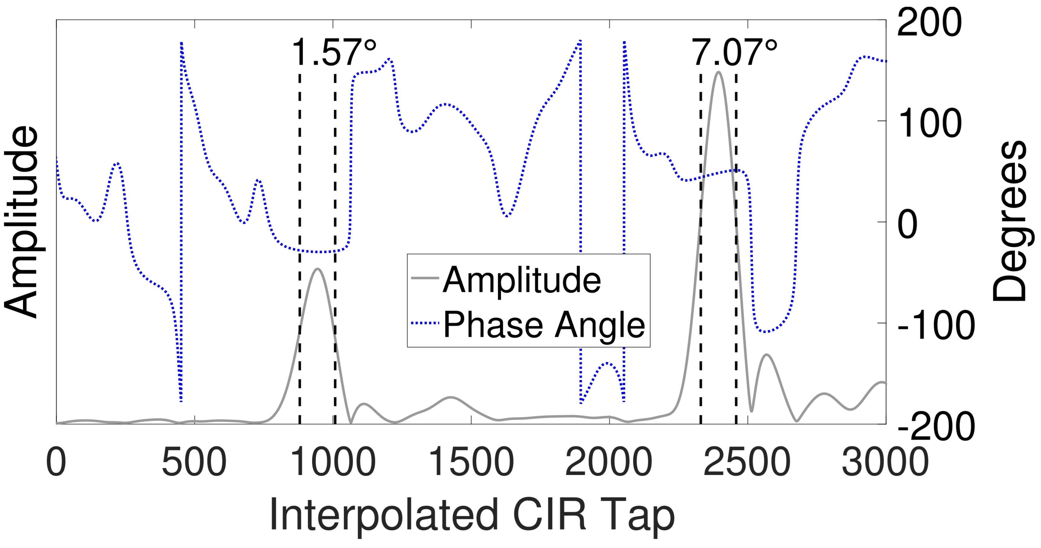
Phase to the rescue
0
10
20
30
Time (nanoseconds)
Phase is more stable
Notes:
Therefore, the phase under a CIR peak remains fairly constant over a larger time span. We can therefore compare phases to improve precision.

Slide 39
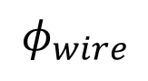
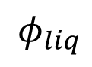
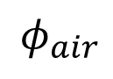
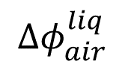
Double Differencing – Phase
$$φ_{air}$$
e
d
u
t
i
l
$$φ_{wire}$$
$$Δφ_{air}^{liq}$$
p
m
A
$$φ_{liq}$$
0
5
10
15
20
0
500
1000
1500
2000
Time (nanoseconds)
$$Δφ_{air}^{liq}=\left(φ_{liq}−φ_{wire}\right)−(φ_{air}−φ_{wire})$$
CIR Tap
Notes:
Again, we want to determine how much the phase changed because of the introduction of the liquid. After aligning the phases at the red peak, we can measure the phase difference between the blue and the green peak. It is tempting to denote this phase difference as a measure of signal slowdown.

Slide 40
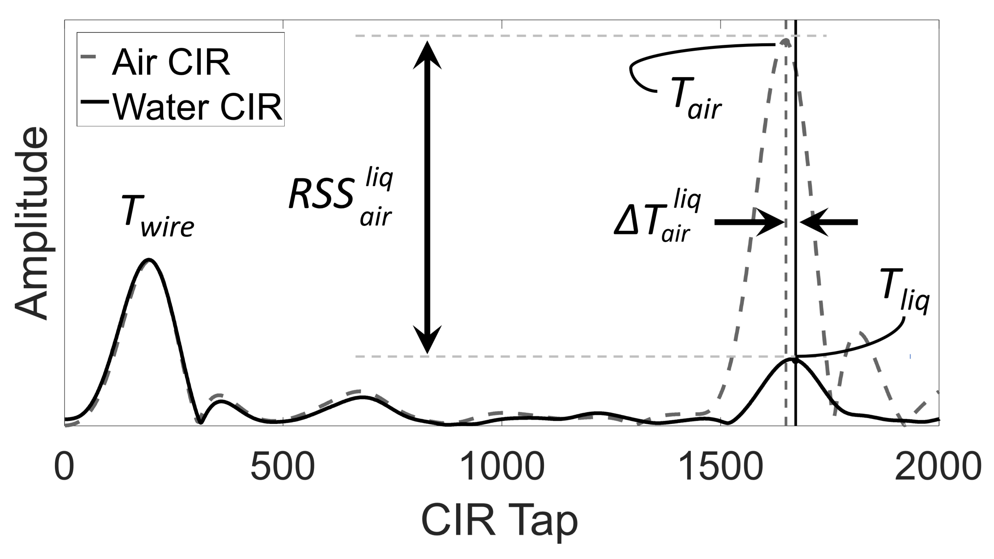
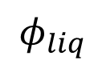


Double Differencing – Phase
Phase $φ$ can be arbitrary, but difference is meaningful
$$φ_{air}$$
Phase wraps
$$φ_{wire}$$
$$Δφ_{air}^{liq}$$
$$φ_{liq}$$
0
5
10
15
20
Time (nanoseconds)
$$Δφ_{air}^{liq}=\left(φ_{liq}−φ_{wire}\right)−(φ_{air}−φ_{wire})$$
Notes:
Sadly, that is not the case. Phase wraps every 360 degrees.

Slide 41
Phase Wraps
Using just phase is ambiguous
Need some notion of absolute distance
λ
λ
λ
λ
λ
Notes:
Just knowing the phase shift alone is not sufficient since the results will be ambiguous. We also need to know how many wavelengths the CIR peak has shifted by.

Slide 42
Double Differencing –ToF
Air CIR
T_{air}
e
Water CIR
d
u
T_{wire}
liq
t
ΔT
i
l
air
p
m
A
T_{liq}
0
5
10
15
20
0
500
1000
1500
2000
Time (nanoseconds)
CIR Tap
Notes:
So we cannot completely let go of the time of flight information from our peak detection.

Slide 43
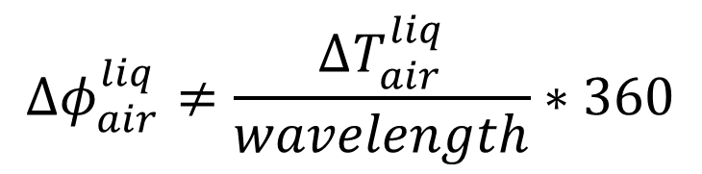
Improvements using Phase
$$Δφ_{air}^{liq}≠\frac{ΔT_{air}^{liq}}{wavelength}∗360$$
λ
λ
λ
λ
λ
TOF
Notes:
We use this coarse grained time of flight to disambiguate the phase and readjust the final time of flight estimate.

Slide 44
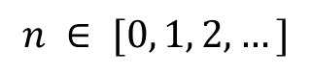
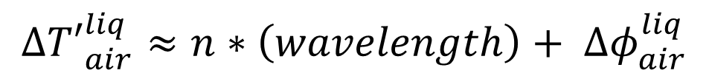
Improvements using Phase
$$Δ{T′}_{air}^{liq}≈n∗\left(wavelength\right)+ Δφ_{air}^{liq}$$
$$n ∈ [0, 1, 2,…]$$
λ
λ
λ
λ
λ
TOF
Notes:
Allowing us to obtain a very accurate estimate of the slowdown.

Slide 45
Key Properties of Liquids
✓
Refractive index
Attenuation factor
Notes:
With this refined estimate of time of flight, we are able to obtain the refractive index of the liquid. We are still left with the attenuation factor. Luckily, the same reference wire that helped obtain better ToF estimate will help us with attenuation factor as well.

Slide 46
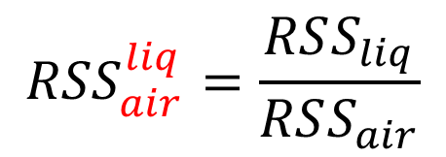
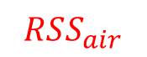
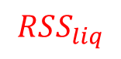
Estimating Attenuation
Air CIR
$$RSS_{air}$$
T_{air}
e
Water CIR
d
u
T_{wire}
t
$${RSS}_{air}^{liq}=\frac{RSS_{liq}}{RSS_{air}}$$
i
l
p
m
T_{liq}
A
$$RSS_{liq}$$
0
5
10
15
20
0
500
1000
1500
2000
Time (nanoseconds)
CIR Tap
Notes:
Which is obtained from the ratio of the wireless peaks with and without the liquid. The alignment at the wired peak eliminates the effect of slight differences in the amplifier gains, automatic gain control, and hardware noise on the received signal strength.

Slide 47
Key Properties of Liquids
✓
Refractive index
✓
Attenuation factor
Notes:
So now, we have both refractive index and attenuation. This is the unique tuple we were after and it will enable us to identify liquids.

Slide 48
Results
Notes:
Let us look at the results now.

Slide 49
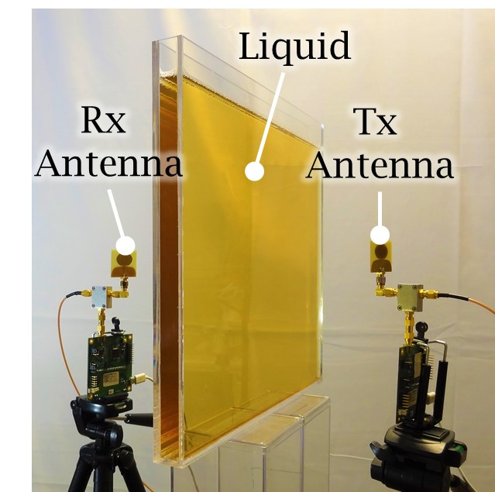
Experimental Setup
Used Decawave Trek 1000 UWB devices at 4GHz
38cm x 36cm liquid container
33 liquids spanning a large part of the refractive index spectrum
Notes:
In our evaluation setup, we use two Decawave UWB devices as wireless transmitter and receiver and continuously send a short wireless packet. The center frequency is 4GHz and the bandwidth is 1GHz. First, CIR data is collected without the liquid, and then the liquid is introduced. The double differencing technique we discussed are applied on this data and refractive index and attenuation factor is obtained. We did this for 33 different liquids that span a large part of the refractive index space.

Slide 50
Baseline: Vector Network Analyzer
VNA + Dielectric Probe method for creating a baseline
Measures the liquid’s complex permittivity
Published error is 5%
Notes:
We used a Vector Network Analyzer and a dielectric probe to obtain a ground truth to compare against. This ground truth setup actually measures the complex permittivity and so we converted our measured refractive index and attenuation factor to the complex permittivity as well. Our experiments and the baseline were testing exactly the same liquids and exactly at the same frequency of 4GHz.

Slide 51
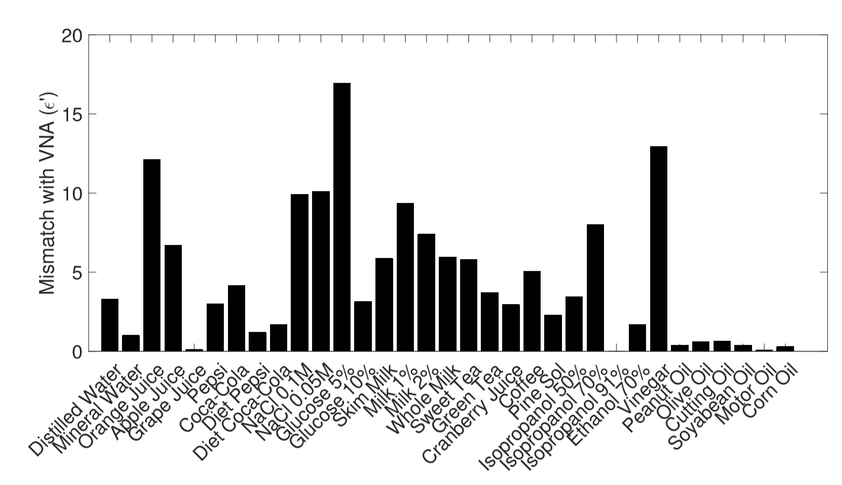
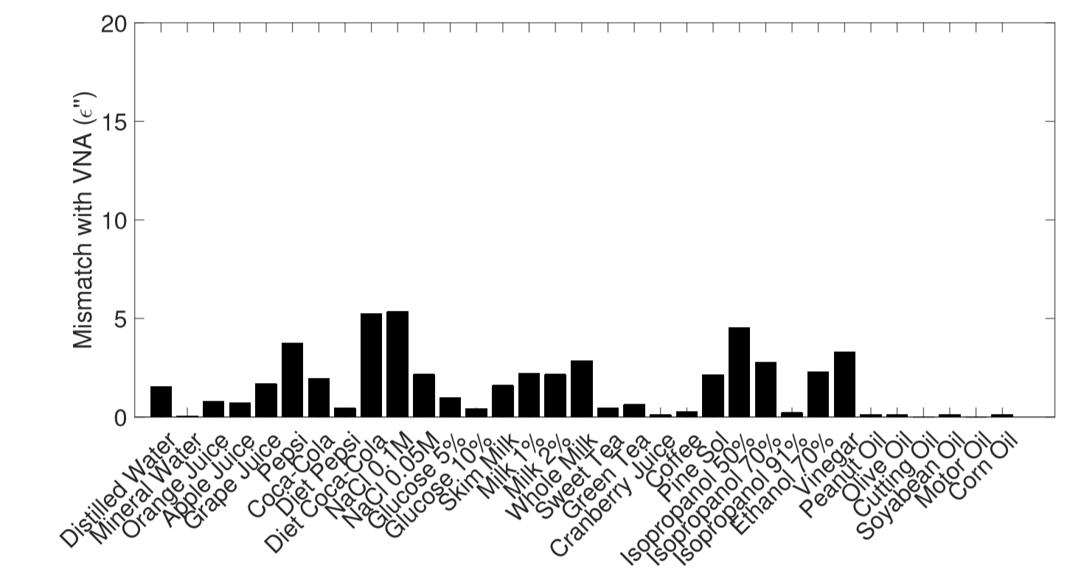


Results – Permittivity
Median Error in $ε^{′}$ is under 9%
Median Error in $ε^{′′}$ is under 12%
Notes:
We compared the obtained permittivity using our method with the baseline permittivity. On an average, our error is at 9%. This is comparable to the VNA’s published error margin of 5%.

Slide 52

Results – Identification
Glucose
Notes:
Most of the liquids could be easily identified during repeated tests with the LiquID setup. During each test, the permittivity was calculated and the closest matching liquid was returned as the result.

Slide 53


Limitations and Future work
Composition of Mixtures
Container Shape
Notes:
Of course there are limitations to what we can achieve. We cannot tell components of a mixture, and containers of any size and shape remain an open problem.

Slide 54
Conclusion
Pepsi
Coca-Cola
Notes:
We set out to identify liquids by shining wireless signals through them. We had the option of using machine learning where we could have looked at the various features of the outcoming signals and could have run classifiers on it. However we decided to not do machine learning and rather, modeled the actual signal behavior using properties of physics and ultimately arrived at the refractive index and attenuation factor. This is the reason we believe our techniques are generalizable even though this paper shows results for only 33 liquids.

Slide 55


Thank You
dhekne2@Illinois.edu
Notes:
I appreciate everyone in my lab for putting up with the liquidy mess I created during this project. Thank you so much for listening, and I will take questions now.

Slide 56
End of Presentation

Slide 57
Backup Slides

Slide 58

Discrete CIR to interpolated
Time (nanoseconds)

Slide 59


Impedance Mismatch in Liquids
t_{E}^{air→target}
t_{E}^{target→air}
d
Incident signal
Received signal
$$t_{E}=\frac{2Z_{2}}{Z_{2}+Z_{1}}$$
Reflected signal
Reflected signal
1
d
Attenuation =
α_{d}
e

Slide 60

Container Compensation
Empty container’s complex permittivity is also obtained with the same technique
Our container was made of acrylic with permittivity of about 3.45+0j

Slide 61
Diffraction Problems
Diffraction can cause signals to go around an obstacle
Diffracted signals may arrive before the refracted signal!
This corrupts the time of flight estimate
We deal with diffraction by using a large container – more than 4 wavelengths on either side

Slide 62
Extreme Conductivity
Extremely conductive liquids, such as 1 molar saline solution, will not allow RF signals to penetrate
LiquID will fail to estimate the permittivity of such liquids
However, it can definitely indicate that the liquid is extremely conductive.

Slide 63
Tagscan
Only differentiates between liquid with a certain phase relationship with each other.
Lacks any notion of actual delay or time of flight
Works only with liquids with similar refractive index to each other.

Slide 64

Tagscan (cont…)

Slide 65


Permittivity from RI and AF
$$Refractive Index= \sqrt{\frac{1}{2}ε^{′}\left\{\sqrt{1+{\left(\frac{ε^{′′}}{ε^{′}}\right)}^{2}}+1\right\}}$$
$$Attenuation Factor= \frac{λ_{0}}{2π}\sqrt{\frac{2}{ε′\left(\sqrt{1+{\left(\frac{ε′′}{ε′}\right)}^{2}}−1\right)}}$$
Solve for $ε^{′}$ and $ε^{′′}$
Notes:
The refractive index and attenuation factor for each liquid are then passed through a non-linear solver to obtain the complex permittivity of the liquid.

Slide 66
End of backup slides

Slide 67
Estimating Attenuation
Shows the
attenuation
Notes:
The reduction in the signal strength after introduction of a liquid is used, along with the refractive index to derive the complex permittivity of that liquid.

Slide 68



Estimating Attenuation
Air CIR
$$RSSI_{air}$$
e
Water CIR
d
u
t
i
l
p
$$RSSI_{wire}$$
m
A
$$RSSI_{liq}$$
0
500
1000
1500
2000
CIR Tap

Slide 69



Double Differencing – RSSI
Air CIR
$$RSSI_{air}$$
e
Water CIR
d
u
t
$${RSSI}_{wire}^{air}=\frac{RSSI_{air}}{RSSI_{wire}}$$
i
l
p
$$RSSI_{wire}$$
m
A
$$RSSI_{liq}$$
0
500
1000
1500
2000
CIR Tap

Slide 70


Estimating Attenuation
Air CIR
$$RSSI_{air}$$
e
Water CIR
d
u
t
$${RSSI}_{wire}^{liq}=\frac{RSSI_{liq}}{RSSI_{wire}}$$
i
l
p
$$RSSI_{wire}$$
m
A
$$RSSI_{liq}$$
0
500
1000
1500
2000
CIR Tap

Slide 71

Estimating Attenuation
Air CIR
$$RSSI_{air}$$
e
Water CIR
d
u
t
$${RSSI}_{air}^{liq}=\frac{RSSI_{liq}}{RSSI_{air}}$$
i
l
p
$$RSSI_{wire}$$
m
A
$$RSSI_{liq}$$
0
500
1000
1500
2000
CIR Tap
Notes:
This RSSI ratio denotes the extent of wireless signal absorption by the liquid.

Slide 72


Existing Solutions – [Deprecated]
Notes:
But isn’t this a solved problem? Surely. Lab technicians frequently test materials using chemical and physical analysis. Most of these methods, however, revolve around heating, treating, or beating, a test sample. All such methods are destructive in nature.

Slide 73
State-of-the-Art is Insufficient
Ultra-wideband radios use 1GHz bandwidth
High sampling rate allows tens of centimeters of precision
Great for localization, yet insufficient for LiquID
Notes:
Commercially available state-of-the-art wireless localization equipment uses ultra-wideband radios with a large 1GHz of wireless bandwidth. It has sampling rates high enough to provide tens of centimeters of precision. We use UWB radios in this work as well, but their out-of-the-box precision is still insufficient for our purpose.

Slide 74
Introducing a Wired Path
Create a reference path
Allows phase based ToF measurements
Allows received signal strength comparisons
Liquid
Wire
Tx
Rx
Notes:
In this work, however, we turn this nuisance into an ally. We purposefully introduce a second path between the transmitter and the receiver, by directly connecting a wire between the two devices. Doing so, enables using phase and comparing received signal strength across different wireless packets both of which are critical to obtaining the complex permittivity of the liquid.

Slide 75

Existing Solutions
Light based techniques fail for opaque materials
Labs typically perform destructive analysis
Rheometer
Notes:
But isn’t this a solved problem? Surely. Lab technicians frequently test materials using chemical and physical analysis. Most of these methods, however, revolve around heating, treating, or beating, a test sample. All such methods are destructive in nature.

Slide 76

Food Quality Assurance
Notes:
Maybe we can ascertain purity of foodstuffs, quality of oils, and prevent adulteration.

Slide 77
Refractive Indices at 4GHz
Vacuum/
Air
Edible Oils
Syth. Oils
Alcohols
Water Solutions
Water
Notes:
Just to provide an intuition of how much electromagnetic waves at 4GHz are slowed down in various liquids, here is a scale of the refractive indices of the liquids we used in our analysis. Inside water, for example, EM waves slow down almost 9 times that of the speed of light. Oils on the other hand cause very little slowdown.

Slide 78

Existing Solutions
Light based techniques fail for opaque materials
Refractometer
Notes:
But isn’t this a solved problem? Surely. Lab technicians frequently test materials using chemical and physical analysis but each technique has its drawbacks. For example, this refractometer studies the bending of light to identify a sample, but fails for opaque samples.

Slide 79
Existing Solutions
Light based techniques fail for opaque materials
Spectrometers and chromatographers are invasive and destructive
Spectrometer
Notes:
Spectrometers involve observing spectral emission lines and chromatographers use different rate of reactions to identify materials.

Slide 80
Existing Solutions
Light based techniques fail for opaque materials
Spectrometers and chromatographers are invasive and destructive
They use heat, and chemical analysis
Chromatograph
Spectrometer
Notes:
But most of these methods, revolve around heating, treating, or beating, a test sample. Doing so destroys the sample and renders it unusable after the process.

Slide 81

Existing Solutions
VNA + Dielectric Probe
Expensive >$100,000
Invasive – needs dipping a probe in the liquid
Notes:
Less destructive techniques exist; such as using a vector network analyzer and a dielectric probe. But these are also extremely bulky and are very expensive equipment. They might still require dipping a probe in the liquid. Not only is this invasive, but it does not work with extremely hot or corrosive materials.

Slide 82
A function of Permittivity
Refractive index = f₁ (Permittivity)
Attenuation Factor = f₂ (Permittivity)
Notes:
Both these properties are a function of the permittivity of the liquid. Hence, if we measure the refractive index and the attenuation factor, we will be able to, in turn, determine the permittivity of the liquid, enabling liquid identification.

Slide 83
Airport Security
✓
LiquID
Notes:
Such a rule is too restrictive for most people. Enabling a quick non-invasive way to identify liquids could enable carrying a bottle of water or a carbonated drink without any problem.

Slide 84
Refractive Index – Snell’s Law?
Measured using light beams and Snell’s law
A similar approach with wireless would require impractical pencil beams
Notes:
Typically, we would measure the refractive index of a transparent material by observing the bending of light rays and applying Snell’s law. An equivalent measurement using wireless signals will be extremely difficult to perform partly because of the much larger wavelength. It would require impractically thin pencil beams.

Slide 85

So near, yet so far!
~10 picoseconds
1 nanosecond
Notes:
Suppose we measure ToF wrong by one nanosecond. Light travels 30cms in 1 nanosecond meaning that our estimate of the refractive index can become very erroneous even with just a nanosecond of ToF error. Put differently, measuring slowdown in a few centimeters of liquid and differentiating between apple juice and orange juice, or coke and Pepsi, will require us to measure time of flight to a few picoseconds of accuracy. Thus even though localization applications measure time of flight, what we desire in this work requires a couple of orders of magnitude better precision.

Slide 86
Opportunity
Ultra-wideband radios give ToF in nanoseconds
Can we do better?
Understanding the internals of UWB may hold the answer
Use the phase of the receive signal
Phase change is a function of the slowdown
However, phase wraps
Notes:
Two opportunities allow us to solve this problem. First, ultra-wideband radios give nanosecond level precision in time of flight. So perhaps by delving deeper into the techniques used by UWB, we might be able to obtain even better precision. The problem here is multipath since it fundamentally limits how much we can improve the ToF precision. Second, the phase of the received signal is also altered by the slowdown. So maybe, if we start to use phase information, we might be able to obtain the required precision of a few picoseconds. However, since phase wraps at the wavelength, this is not trivial.

Slide 87
Key Properties of Liquid
Velocity c
Velocity v
Velocity c
Absorbed
Notes:
When we shine a wireless signal onto a liquid, there are two essential factors we want to understand. First, the signal slows down in the liquid, and second, it is absorbed by the liquid.

Slide 88
Refractive Index – Snell’s Law?
Measured using bending light beams and Snell’s law
“the general case of arbitrary dielectrics and oblique incidence is of great complexity” –Von Hippel
β
α
Notes:
Typically, we would measure the refractive index of a transparent material by observing the bending of light rays and taking the ratio sin(alpha) by sin(beta) which is essentially Snell’s law.
An equivalent measurement using wireless signals will be extremely difficult to perform partly because of the much larger wavelength of wireless signals and because of the possibility of total internal reflection etc. So much so that this problem is referred to as being of great complexity in Von Hippel’s physics text book. So then what do we do?

Slide 89
Attenuation Factor
Absorbed
Reduced
signal strength

Slide 90
ToF gives Refractive Index
$ToF_{liq}−ToF_{air}=$ $\frac{d}{v}−\frac{d}{c}$
Only Unknown
$$Refractive Index=\frac{c}{v}$$
Notes:
d by v minus d by c, where v is the velocity inside the liquid. Thus, by measuring the time of flight very accurately, we can derive the velocity and thereby calculate the refractive index. That is our high level idea in this work.

Slide 91
So near, yet so far!
~10 picoseconds
Soybean Oil?
1 nanosecond
Notes:
Light travels 30cm in one nanosecond. Now say, for a water column of 5cm, we measure the ToF wrong by 1nanosecond. Then the velocity estimate will be almost three times of what it should have been. This will result in the refractive index to be calculated as 2.7 instead of water’s actual refractive index which is around 8.7. Water would get identified as Soybean oil!
Put differently, measuring slowdown in a few centimeters of liquid and differentiating between apple juice and orange juice, or coke and Pepsi, will require us to measure time of flight to a few picoseconds of accuracy. Thus even though localization applications measure time of flight, what we desire in this work requires a couple of orders of magnitude better precision.

Slide 92
Our Contributions
Architecture to improve ToF
Creates a reference path
Cancels out hardware variabilities
Jointly solve phase and ToF
Resolve the phase integer ambiguity
Allows even better ToF precision
Liquid
Wire
Tx
Rx
Notes:
To solve this problem, our contributions are two fold. One is architectural and one is algorithmic. We design an architecture that uses a wired connection between the Tx and the Rx. This creates a reference path for wireless signals that allow us to cancel many variabilities in the hardware and across different wireless packet. Further, we jointly solve the phase of the received signal and ToF to better estimate the slowdown in the liquid. Let me now elaborate a bit about the technical details of our system. What exactly does connecting a wire between the transmitter and the receiver give us?

Slide 93
Limitations and Future Work
Identification of trace adulteration is a challenge
Circular and any-shaped container compensation
Extend to solids – detect various layers
Extend to many frequencies – provide better identification
Realize the applications – simplify airport security
Notes:
Let us talk about some limitations of this work. LiquID, as it stands today, cannot detect trace amounts of adulteration. So, for example, it will not be able to detect a drug added to a drink. Also, identification through any unknown container size and shape is extremely challenging. These remain open problems.
In the future, we plan to extend this work to solids and use many center frequencies to obtain even better identification. We hope to simplify airport security for everyone.

Slide 94
Conclusion
Determining permittivity enables liquid identification
LiquID performs precise time of flight measurements using UWB radios
LiquID achieves the required precision for measuring two basic physical properties of liquids leading to identification
Notes:
In conclusion, LiquID uses complex permittivity, a physical property of all materials, to identify liquids. It does this through analysis of wireless signals and precisely measuring the time of flight of wireless signals through the liquid, without using any machine learning or fingerprinting. We believe that much is to be done in this area and we have just barely scratched the surface.

Slide 95
Key Properties of Liquid
Bending → Refractive Index
Absorption → Attenuation Factor
Notes:
The signal bending is due to the liquid’s refractive index, and the reduction in signal strength is due to its attenuation factor. These two properties together form a tuple, which is quite unique for every liquid.

Slide 96
Refractive Indices at 4GHz
RI at Optical
1.4-1.5
1.3-1.4
1.3-1.6
1.33
Vacuum/
Air
Edible Oils
Syth. Oils
Alcohols
Water Solutions
Water
RI at 4GHz
1
2
3
4
5
6
7
8
9
Notes:
Just to provide an intuition of how much electromagnetic waves at 4GHz are slowed down in various liquids, here is a scale of the refractive indices of the liquids we used in our analysis. Inside water, for example, EM waves slow down almost 9 times that of the speed of light. In contrast, at optical frequencies, water’s refractive index is just 1.33 and most other liquids are also very close. There is much better separation between liquids at 4GHz, and better penetration is possible even for optically opaque materials. It is therefore beneficial to use wireless signals for this analysis.

Slide 97
So near, yet so far!
~10 picoseconds
Soybean Oil?
1 nanosecond
Notes:
Light travels 30cm in one nanosecond. Now, while measuring the ToF for a 5cm water column, if we make a mistake of 1nanosecond. Then the velocity estimate will be almost three times of what it should have been. This will result in the refractive index to be so wrong that water would get identified as Soybean oil!
Put differently, measuring slowdown in a few centimeters of liquid and differentiating between apple juice and orange juice, or coke and Pepsi, will require us to measure time of flight to a few picoseconds of accuracy. Thus even though localization applications measure time of flight, what we desire in this work requires a couple of orders of magnitude better precision.

Slide 98

Refractive Index
$$R.I. = \frac{sinα}{sinβ}$$
“the general case of arbitrary dielectrics and oblique incidence is of great complexity” –Von Hippel
β
α
Notes:
Typically, we would measure the refractive index of a transparent material by observing the bending of light rays and taking the ratio sin(alpha) by sin(beta) which is essentially Snell’s law.
An equivalent measurement using wireless signals will be extremely difficult to perform partly because of the much larger wavelength of wireless signals and because of the possibility of total internal reflection etc. So much so that this problem is referred to as being of great complexity in Von Hippel’s physics text book. So then what do we do?

Slide 99

Refractive Index
$$R.I. = \frac{sinα}{sinβ}= \frac{c}{v}$$
Velocity c
Velocity v
Velocity c
β
α
Notes:
Well, things become much easier if you actually shine the signal perpendicular to the surface. What do we lose? The signals do not bend, they just go straight, so we cannot measure the angle anymore. But, the signal slows down because it is going through a different material.

Slide 100
Refractive Index
$$R.I. = \frac{sinα}{sinβ}= \frac{c}{v}$$
Velocity c
Velocity v
Velocity c
β
α
Notes:
Of course, refractive index is also defined as the ratio of the speed of light in vacuum to that in the liquid. So if we can measure the time the signal takes to go from point A to point B, with the liquid in between, different liquids will change this time differently. If we can measure this time accurately, we can infer the refractive index.

Slide 101
Results – Identification
Notes:
Most of the liquids could be easily identified during repeated tests with the LiquID setup. During each test, the permittivity was calculated and the closest matching liquid was returned as the result.

